Slide 1
Building Knowledge Graph for Hearthstone cards & decks
Xuyang Wang, Yuqin Chen

Slide 2
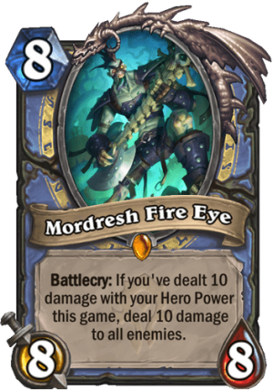
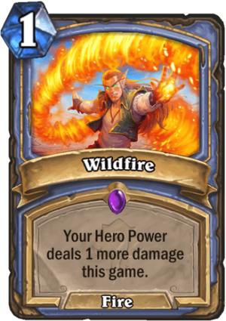
Goal / Objective
Building a knowledge graph about Hearthstone cards & decks
SECRET MAGE
(a deck)
MORDRESH FIRE EYE
(a card)
Battlecry: If you've dealt 10 damage with your Hero Power this game, deal 10 damage to all enemis.
Mana Cost: 8
Attack: 8
Health: 8
Rarity: Legendary
Class: Mage
Type: Minion
Set: Forged in the Barrens
Mechanics: Battlecry, Damage All
…
MORDRESH FIRE EYE
(a card)
Battlecry: If you've dealt 10 damage with your Hero Power this game, deal 10 damage to all enemis.
Mana Cost: 8
Attack: 8
Health: 8
Rarity: Legendary
Class: Mage
Type: Minion
Set: Forged in the Barrens
Mechanics: Battlecry, Damage All
MORDRESH FIRE EYE
(a card)
Battlecry: If you've dealt 10 damage with your Hero Power this game, deal 10 damage to all enemis.
Mana Cost: 8
Attack: 8
Health: 8
Rarity: Legendary
Class: Mage
Type: Minion
Set: Forged in the Barrens
Mechanics: Battlecry, Damage All
MORDRESH FIRE EYE
(a card)
Battlecry: If you've dealt 10 damage with your Hero Power this game, deal 10 damage to all enemis.
Mana Cost: 8
Attack: 8
Health: 8
Rarity: Legendary
Class: Mage
Type: Minion
Set: Forged in the Barrens
Mechanics: Battlecry, Damage All
Wildfile
(a card)
Mana Cost: 1
Rarity: Epic
Class: Mage
Type: Spell
Set: Forged in the Barrens
Wildfile
(a card)
Mana Cost: 1
Rarity: Epic
Class: Mage
Type: Spell
Set: Forged in the Barrens
Wildfile
(a card)
Mana Cost: 1
Rarity: Epic
Class: Mage
Type: Spell
Set: Forged in the Barrens
Wildfile
(a card)
Mana Cost: 1
Rarity: Epic
Class: Mage
Type: Spell
Set: Forged in the Barrens
Wildfile
(a card)
Mana Cost: 1
Rarity: Epic
Class: Mage
Type: Spell
Set: Forged in the Barrens
Wildfile
(a card)
Mana Cost: 1
Rarity: Epic
Class: Mage
Type: Spell
Set: Forged in the Barrens

Slide 3
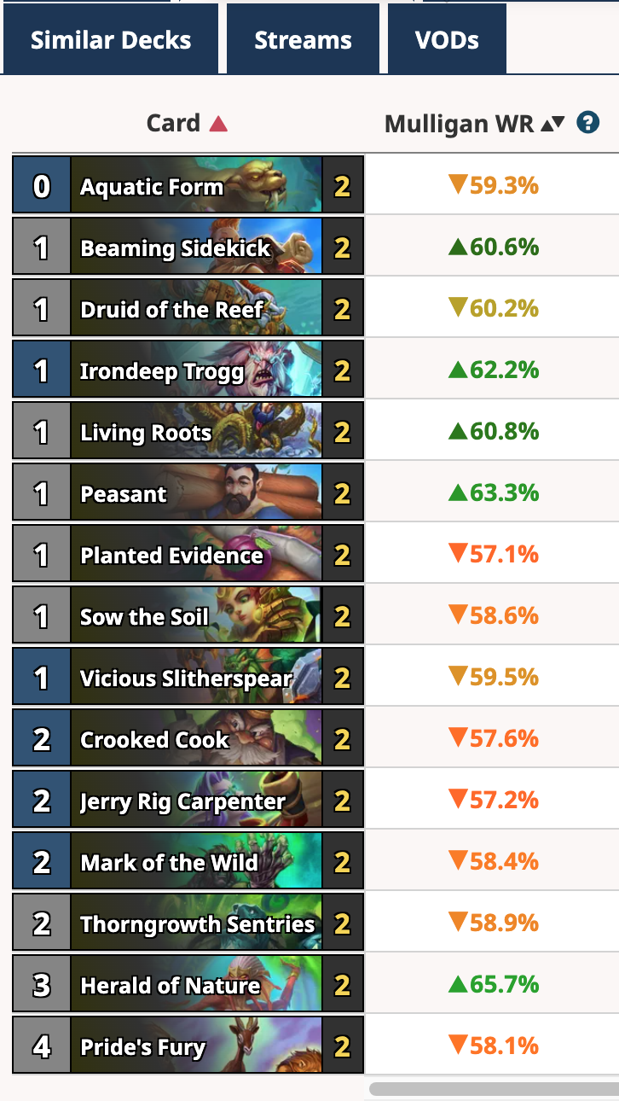
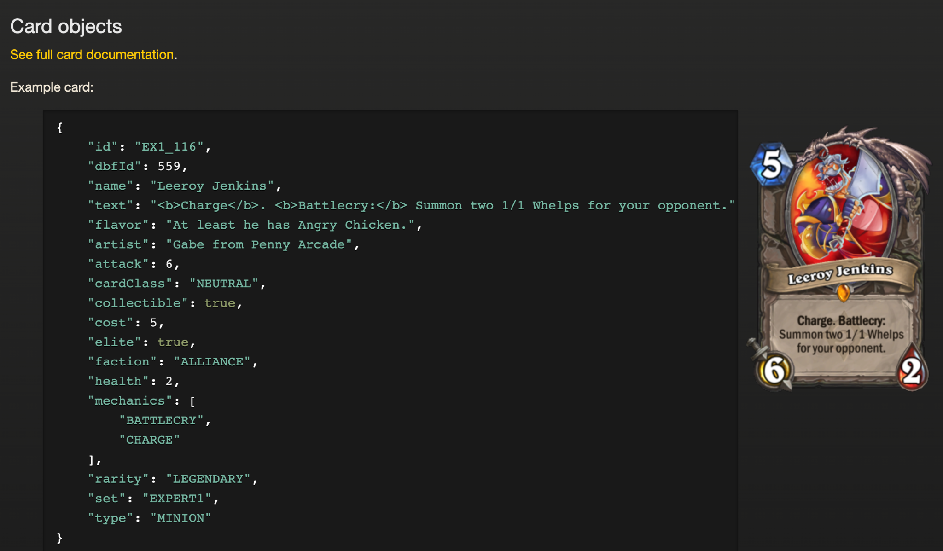
Data Sourse
Decks:
https://hsreplay.net/decks/ Decks: https://www.hearthstonetopdecks.com/
HearthstoneJSON
https://hearthstone.blizzard.com/en-us/cards

Slide 4







Technical Challenge
Card & Deck KG
Embedding and training
Recommend cards
Unstructured Data

